Slide 1

GEOG0113 Lecture 002 Carbon and Climate
P. Lewis
UCL Geography
& NERC NCEO

Slide 2
Aims of lecture
In this lecture, we will:
consider the importance of understanding the science of climate change
look at basic principles of energy transfer in the earth system
examine greenhouse gases and their sources

Slide 3
Terrestrial Climate and Climate Change
“(C)limate change is a defining issue of our generation. Our responses to the challenges of climate change - accurate prediction, equitable adaptation, and efficient mitigation - will influence the quality of life for ... the world, for generations to come.” (NASA, 2010).

Slide 4
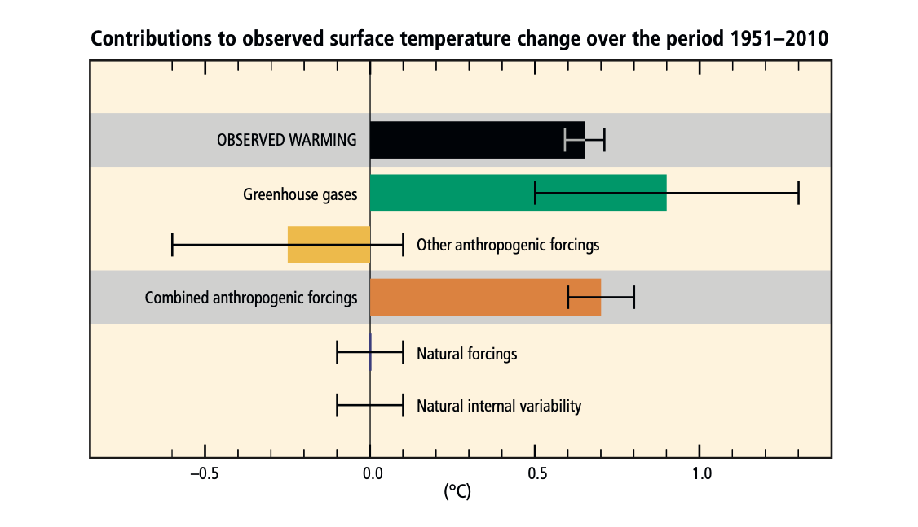
From the IPCC AR5 (synthesis report):
Observed changes and their causes
Human influence on the climate system is clear, and recent anthropogenic emissions of greenhouse gases are the highest in history. Recent climate changes have had widespread impacts on human and natural systems.
Notes:
The best estimate of the human-induced contribution to warming is similar to the observed warming over this period (Figure SPM.3). Figure SPM.3 | Assessed likely ranges (whiskers) and their mid-points (bars) for warming trends over the 1951–2010 period from well-mixed greenhouse gases, other anthropogenic forcings (including the cooling effect of aerosols and the effect of land use change), combined anthropogenic forcings, natural forcings and natural internal climate variability (which is the element of climate variability that arises spontaneously within the climate system even in the absence of forcings). The observed surface temperature change is shown in black, with the 5 to 95% uncertainty range due to observational uncertainty. The attributed warming ranges (colours) are based on observations combined with climate model simulations, in order to estimate the contribution of an individual external forcing to the observed warming. The contribution from the combined anthropogenic forcings can be estimated with less uncertainty than the contributions from greenhouse gases and from other anthropogenic forcings separately. This is because these two contributions partially compen- sate, resulting in a combined signal that is better constrained by observations. {Figure 1.9}

Slide 5
From the IPCC AR5 (synthesis report):
Future Climate Changes, Risks and Impacts
Continued emission of greenhouse gases will cause further warming and long-lasting changes in all components of the climate system, increasing the likelihood of severe, pervasive and irreversible impacts for people and ecosystems. Limiting climate change would require substantial and sustained reductions in greenhouse gas emissions which, together with adaptation, can limit climate change risks.
Future Pathways for Adaptation, Mitigation and Sustainable Dewvelopment
Adaptation and mitigation are complementary strategies for reducing and managing the risks of climate change. Substantial emissions reductions over the next few decades can reduce climate risks in the 21st century and beyond, increase prospects for effective adaptation, reduce the costs and challenges of mitigation in the longer term, and contribute to climate-resilient pathways for sustainable development.
Adaptation and Mitigation
Many adaptation and mitigation options can help address climate change, but no single option is sufficient by itself. Effective implementation depends on policies and cooperation at all scales, and can be enhanced through integrated responses that link adaptation and mitigation with other societal objectives.

Slide 6
From the IPCC AR5 (synthesis report):
Warming of the climate system is unequivocal, and since the 1950s, many of the observed changes are unprecedented over decades to millennia. The atmosphere and ocean have warmed, the amounts of snow and ice have diminished, sea level has risen, and the concentrations of greenhouse gases have increased
Each of the last three decades has been successively warmer at the Earth’s surface than any preceding decade since 1850 (see Figure SPM.1). In the Northern Hemisphere, 1983–2012 was likely the warmest 30-year period of the last 1400 years (medium confidence)
The atmospheric concentrations of carbon dioxide, methane, and nitrous oxide have increased to levels unprecedented in at least the last 800,000 years. Carbon dioxide concentrations have increased by 40% since pre-industrial times, primarily from fossil fuel emissions and secondarily from net land use change emissions. The ocean has absorbed about 30% of the emitted anthropogenic carbon dioxide, causing ocean acidification

Slide 7
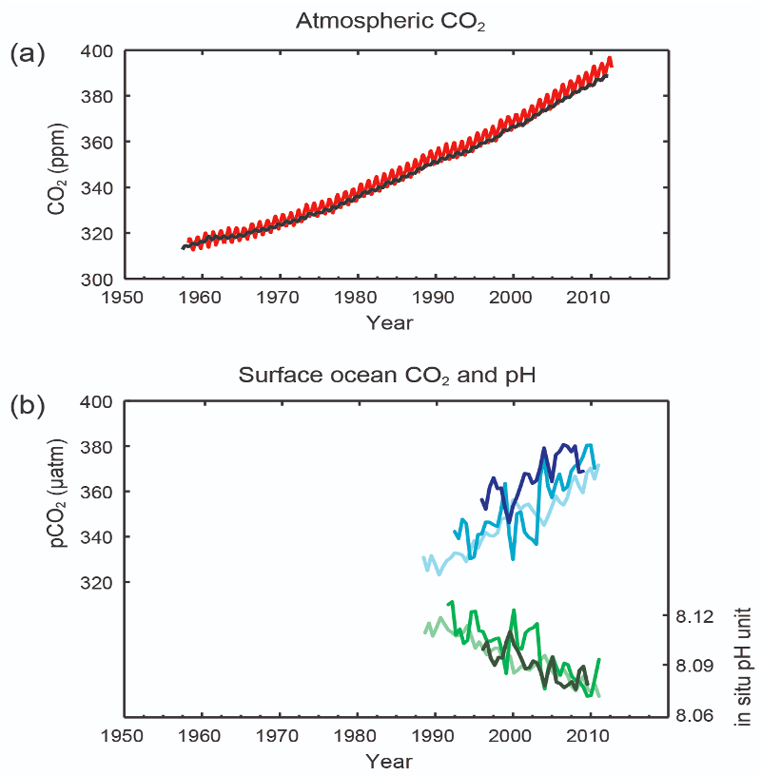
From the IPCC AR5 (synthesis report):
Mauna Loa red, S. Pole gray

Slide 8
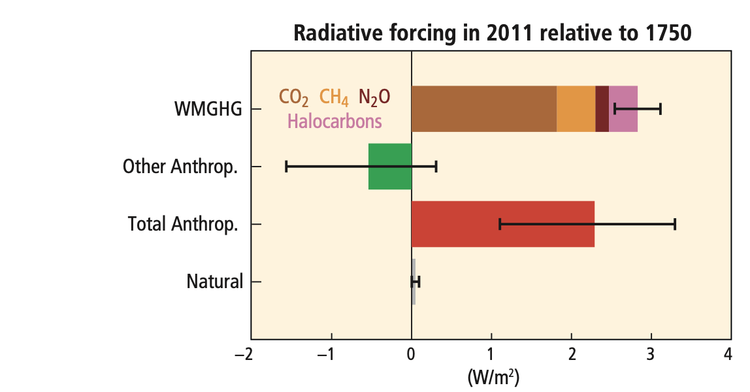
Radiative Forcing
Notes:
"Radiative forcing of climate change during the industrial era (1750–2011). Bars show radiative forcing from well-mixed greenhouse gases (WMGHG), other anthropogenic forcings, total anthropogenic forcings and natural forcings. The error bars indicate the 5 to 95% uncertainty. Other anthropogenic forcings include aerosol, land use surface reflectance and ozone changes. Natural forcings include solar and volcanic effects. The total anthropogenic radiative forcing for 2011 relative to 1750 is 2.3 W/m2 (uncertainty range 1.1 to 3.3 W/m2). This corresponds to a CO2-equivalent concentration (see Glossary) of 430 ppm (uncertainty range 340 to 520 ppm). {Data from WGI 7.5 and Table 8.6}"

Slide 9
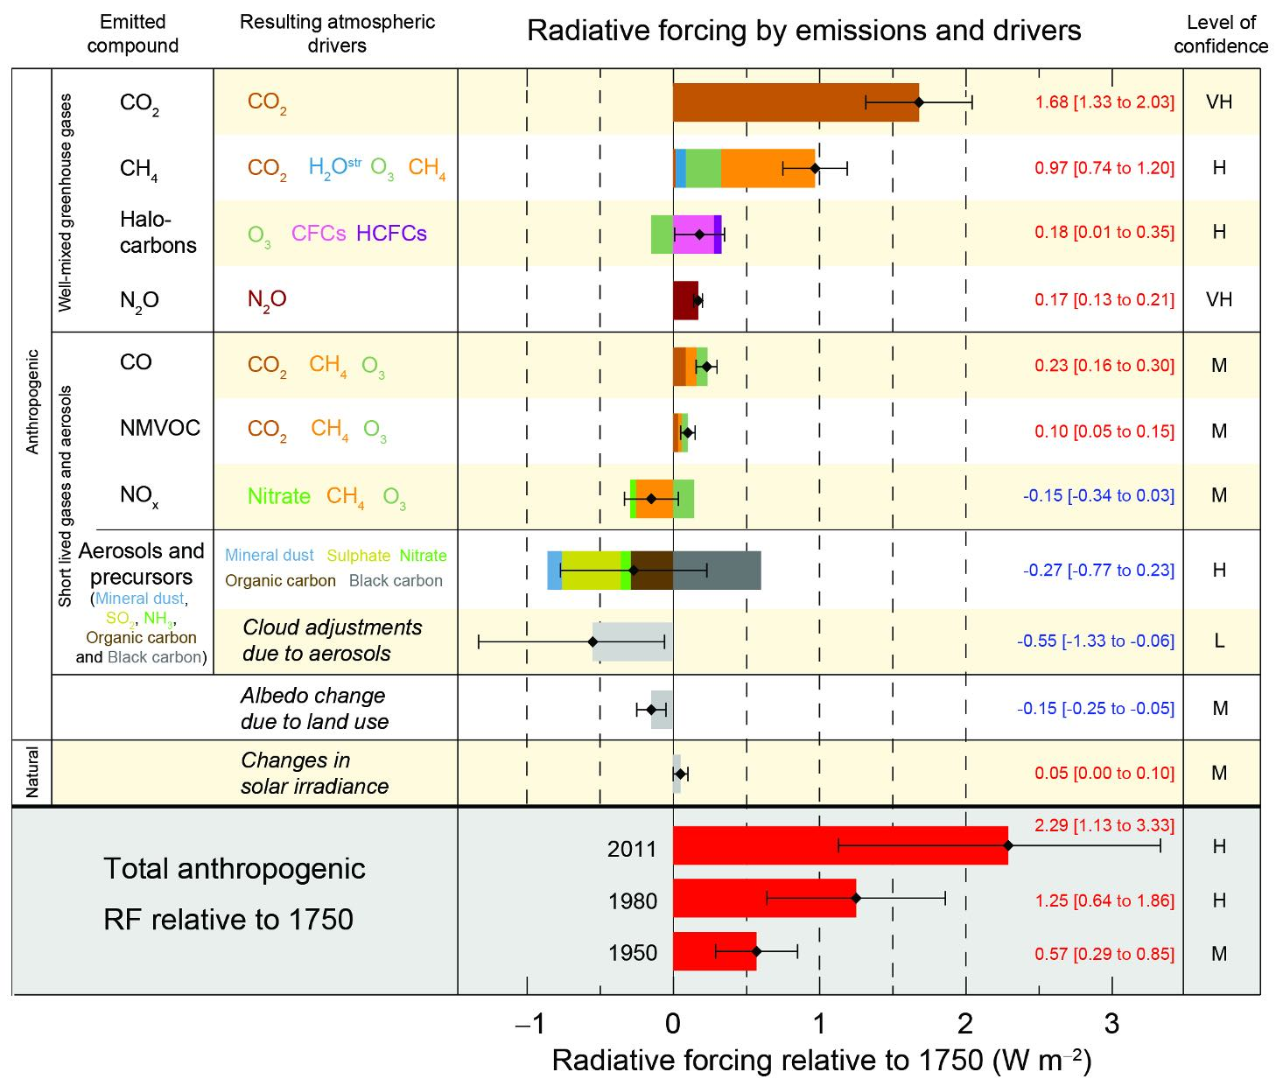
Notes:
This figure from AR4

Slide 10
From the IPCC AR5 (synthesis report)
Causes of change
Total radiative forcing is positive, and has led to an uptake of energy by the climate system. The largest contribution to total radiative forcing is caused by the increase in the atmospheric concentration of CO2 since 1750
The total anthropogenic RF for 2011 relative to 1750 is 2.29 [1.13 to 3.33] Wm⁻² (see Figure SPM.5), and it has increased more rapidly since 1970 than during prior decades. The total anthropogenic RF best estimate for 2011 is 43% higher than that reported in AR4 for the year 2005. This is caused by a combination of continued growth in most greenhouse gas concentrations and improved estimates of RF by aerosols indicating a weaker net cooling effect
Climate models have improved since the AR4. Models reproduce observed continental- scale surface temperature patterns and trends over many decades, including the more rapid warming since the mid-20th century and the cooling immediately following large volcanic eruptions (very high confidence)

Slide 11
IPCC SR1.5 Nov 2018
An IPCC special report on the impacts of global warming of 1.5 C above pre-industrial levels and related global greenhouse gas emission pathways, in the context of strengthening the global response to the threat of climate change, sustainable development, and efforts to eradicate poverty.
https://www.ipcc.ch/sr15/
READ THE REPORT

Slide 12
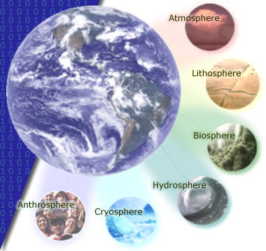
The 'spheres' of influence on the climate system

Slide 13
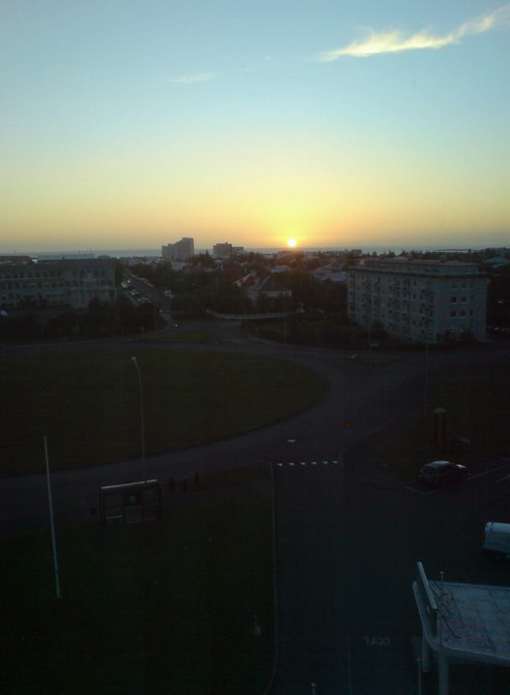
Energy transfer: basics
Driven by solar radiation

Slide 14
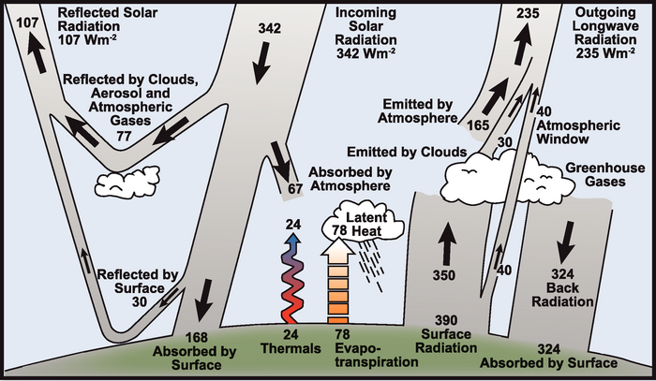
Earth’s climate is driven by (shortwave) solar radiation
Notes:
Around 31% of this incoming radiation is reflected by clouds, aerosols and gases in the atmosphere and by the land surface. The remaining 69% is absorbed, with almost 50% of the incoming radiation being absorbed at the Earth surface.
The shortwave radiation absorbed at the surface is, in the long term, transferred back to the atmosphere, so that around 69% of the incoming energy flux is re-rediated to space as longwave radiation.
The energy absorbed at the surface drives thermals (atmospheric convection) and evapo-transpiration (latent heat transfer: change of state of water). The rest of the energy balance is maintained by thermal (longwave) radiation emitted by the surface, the atmosphere and clouds.

Slide 15
large proportion of longwave radiation emitted by the surface is re-radiated back to the surface (and absorbed by the surface) by clouds and so-called greenhouse gases
‘trapping’ of longwave radiation naturally maintains temperature on Earth – the ‘natural greenhouse effect’.
Without this, temperature much less that it presently is (-19C)

Slide 16
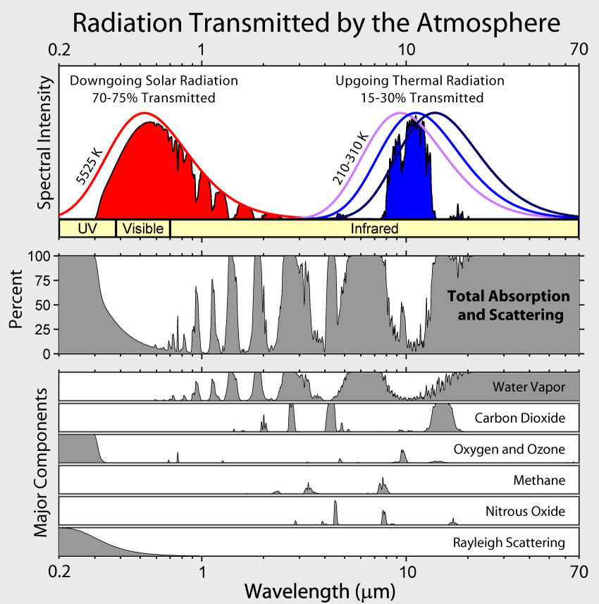
Atmospheric absorption
Notes:
major absorbing (and scattering, other than aerosols) constituents of the atmosphere for shortwave and longwave wavelengths and their impact on atmospheric transmission. … discuss + mention clouds & aerosols

Slide 17
Radiative Forcing
measure of the radiative impact of components of the climate system
“a measure of the influence a factor has in altering the balance of incoming and outgoing energy in the Earth-atmosphere system and is an index of the importance of the factor as a potential climate change mechanism. ... radiative forcing values are for changes relative to preindustrial conditions defined at 1750 and are expressed in watts per square meter (W/m^2).” IPCC AR4
AR4: most likely value of (net positive) radiative forcing due to anthrogenic sources is about an order of magnitude larger than the estimated radiative forcing from changes in solar irradiance.

Slide 18
Rockstrom et al. (2009)
“human changes to atmospheric CO2 concentrations should not exceed 350 parts per million by volume, and that radiative forcing should not exceed 1 watt per square metre above pre-industrial levels. Transgressing these boundaries will increase the risk of irreversible climate change, such as the loss of major ice sheets, accelerated sea- level rise and abrupt shifts in forest and agri- cultural systems. Current CO2 concentration stands at 387 p.p.m.v. and the change in radiative forcing is 1.5 W m^-2”
What about more recently? Paris agreement Dec 2015:
The Paris Agreement’s central aim is to strengthen the global response to the threat of climate change by keeping a global temperature rise this century well below 2 degrees Celsius above pre-industrial levels and to pursue efforts to limit the temperature increase even further to 1.5 degrees Celsius.
http://bigpicture.unfccc.int/#content-the-paris-agreemen

Slide 19
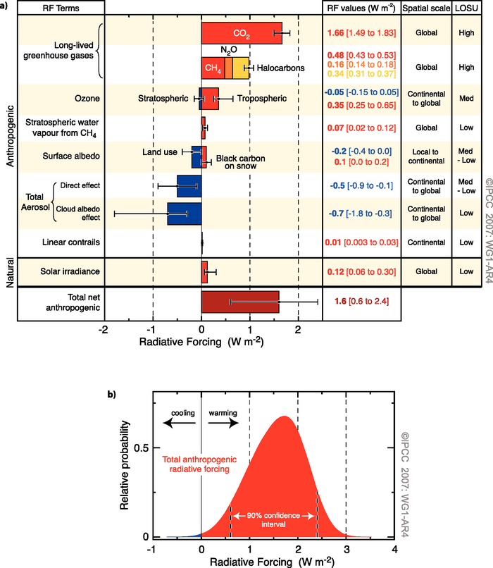
Radiative forcings
RF for different mechanisms
most significant anthropogenic positive RF term is CO2 followed by CH4, Tropospheric O3, Halocarbons, NO2, (natural) Solar irradiance variations, and black carbon effects on snow (lowering snow albedo).
Notes:
(a) Global mean radiative forcings (RF) and their 90% confidence intervals in 2005 for various agents and mechanisms. Columns on the right-hand side specify best estimates and confidence intervals (RF values); typical geographical extent of the forcing (Spatial scale); and level of scientific understanding (LOSU) indicating the scientific confidence level as explained in Section 2.9. Errors for CH4, N2O and halocarbons have been combined. The net anthropogenic radiative forcing and its range are also shown. Best estimates and uncertainty ranges can not be obtained by direct addition of individual terms due to the asymmetric uncertainty ranges for some factors; the values given here were obtained from a Monte Carlo technique as discussed in Section 2.9. Additional forcing factors not included here are considered to have a very low LOSU. Volcanic aerosols contribute an additional form of natural forcing but are not included due to their episodic nature. The range for linear contrails does not include other possible effects of aviation on cloudiness. (b) Probability distribution of the global mean combined radiative forcing from all anthropogenic agents shown in (a). The distribution is calculated by combining the best estimates and uncertainties of each component. The spread in the distribution is increased significantly by the negative forcing terms, which have larger uncertainties than the positive terms. {2.9.1, 2.9.2; Figure 2.20}

Slide 20
Carbon in the Earth System
4th most abundant element in the universe.
able to bond with itself and many other elements
forms over 10 million known compounds.
present
in the atmosphere as CO2, CH4 etc
in all natural waters as dissolved CO2
in various carbonates in rocks
as organic molecules in living and dead organisms in the biosphere .

Slide 21
Carbon in the Earth System
also important in radiative forcing
Directly
Halocarbons in the atmosphere
black carbon deposits on snow
indirectly
elsewhere (e.g. land cover change).
See Friedlingstein et al 2020 Global Carbon Budget 2020 for the most up-to-date figures including key details of HOW different components are estimated

Slide 22
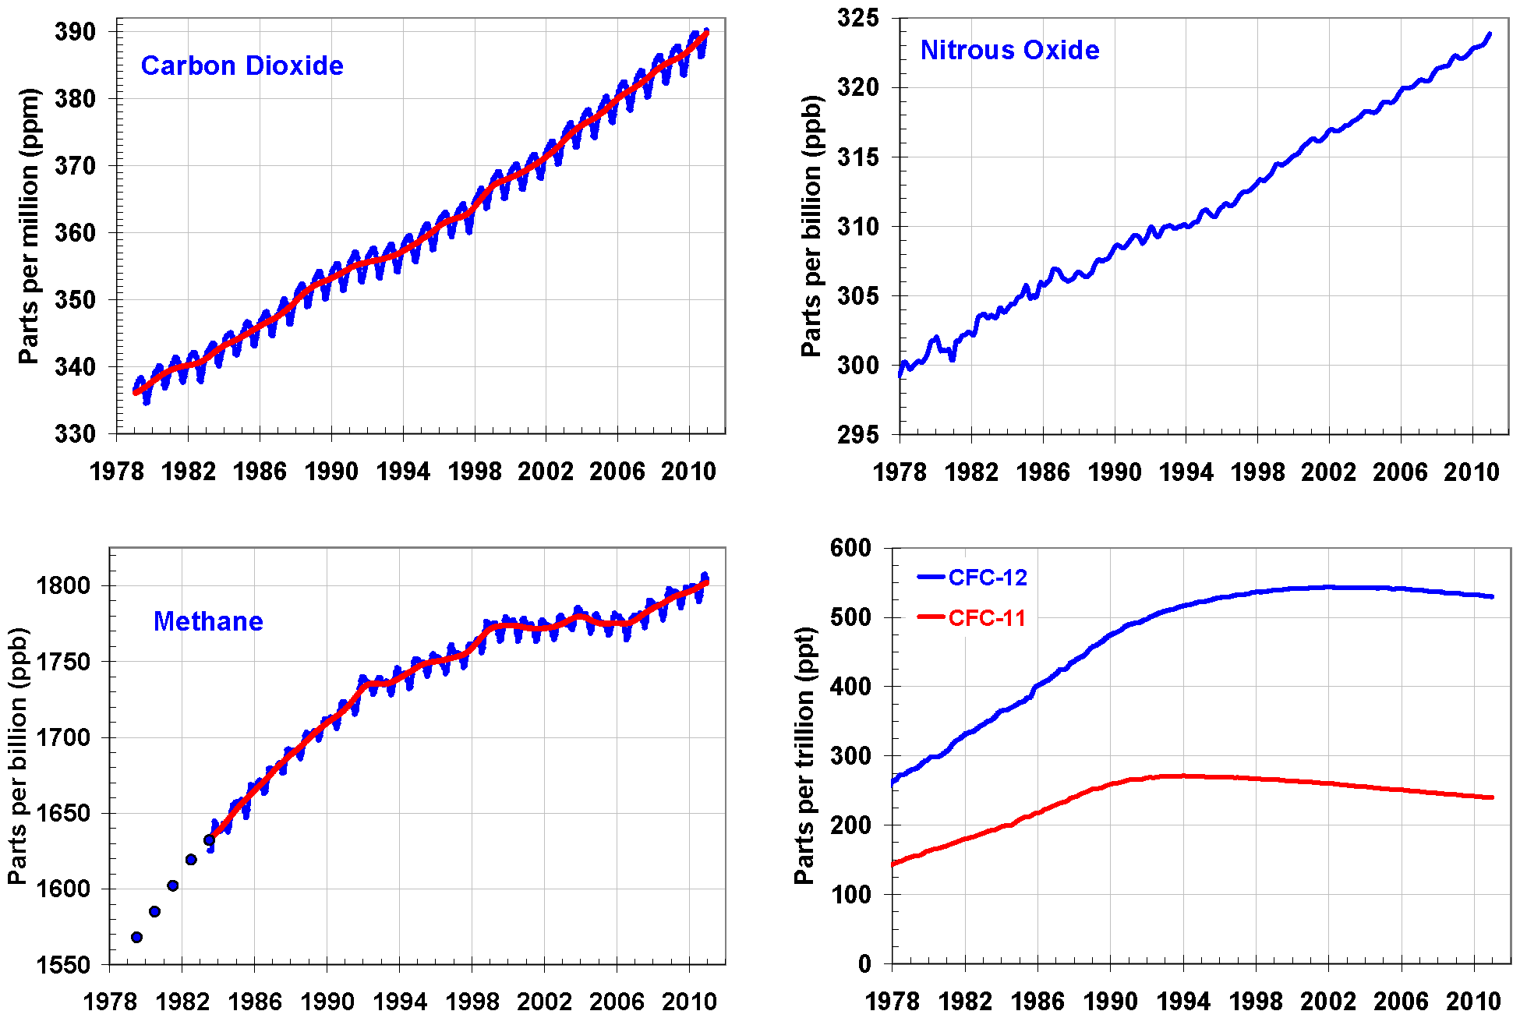
Atmospheric Carbon and Greenhouse Gases
From Le Quéré et al 2018
Notes:
Global average abundances of the major, well-mixed, long-lived greenhouse gases - carbon dioxide, methane, nitrous oxide, CFC-12 and CFC-11 - from the NOAA global air sampling network are plotted since the beginning of 1979. These gases account for about 96% of the direct radiative forcing by long-lived greenhouse gases since 1750. The remaining 4% is contributed by an assortment of 15 minor halogenated gases (see text). Methane data before 1983 are annual averages from Etheridge et al. (1998), adjusted to the NOAA calibration scale [Dlugokencky et al., 2005].

Slide 23
Annual cycles
https://www.esrl.noaa.gov/gmd/ccgg/trends/

Slide 24
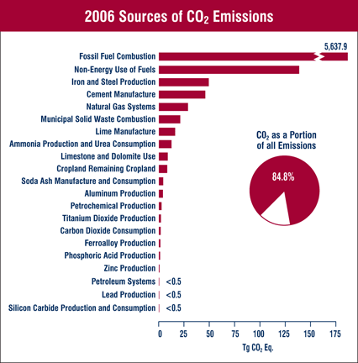
US emissions (2006)
Notes:
Fossil fuel bar far largest

Slide 25
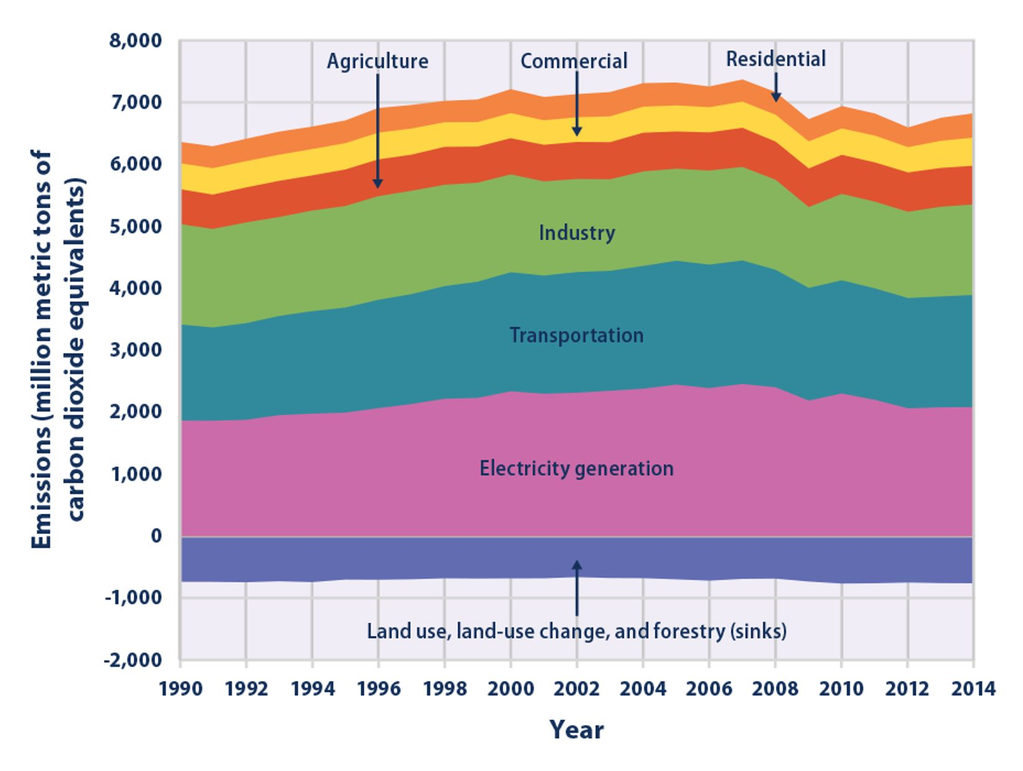

Slide 26
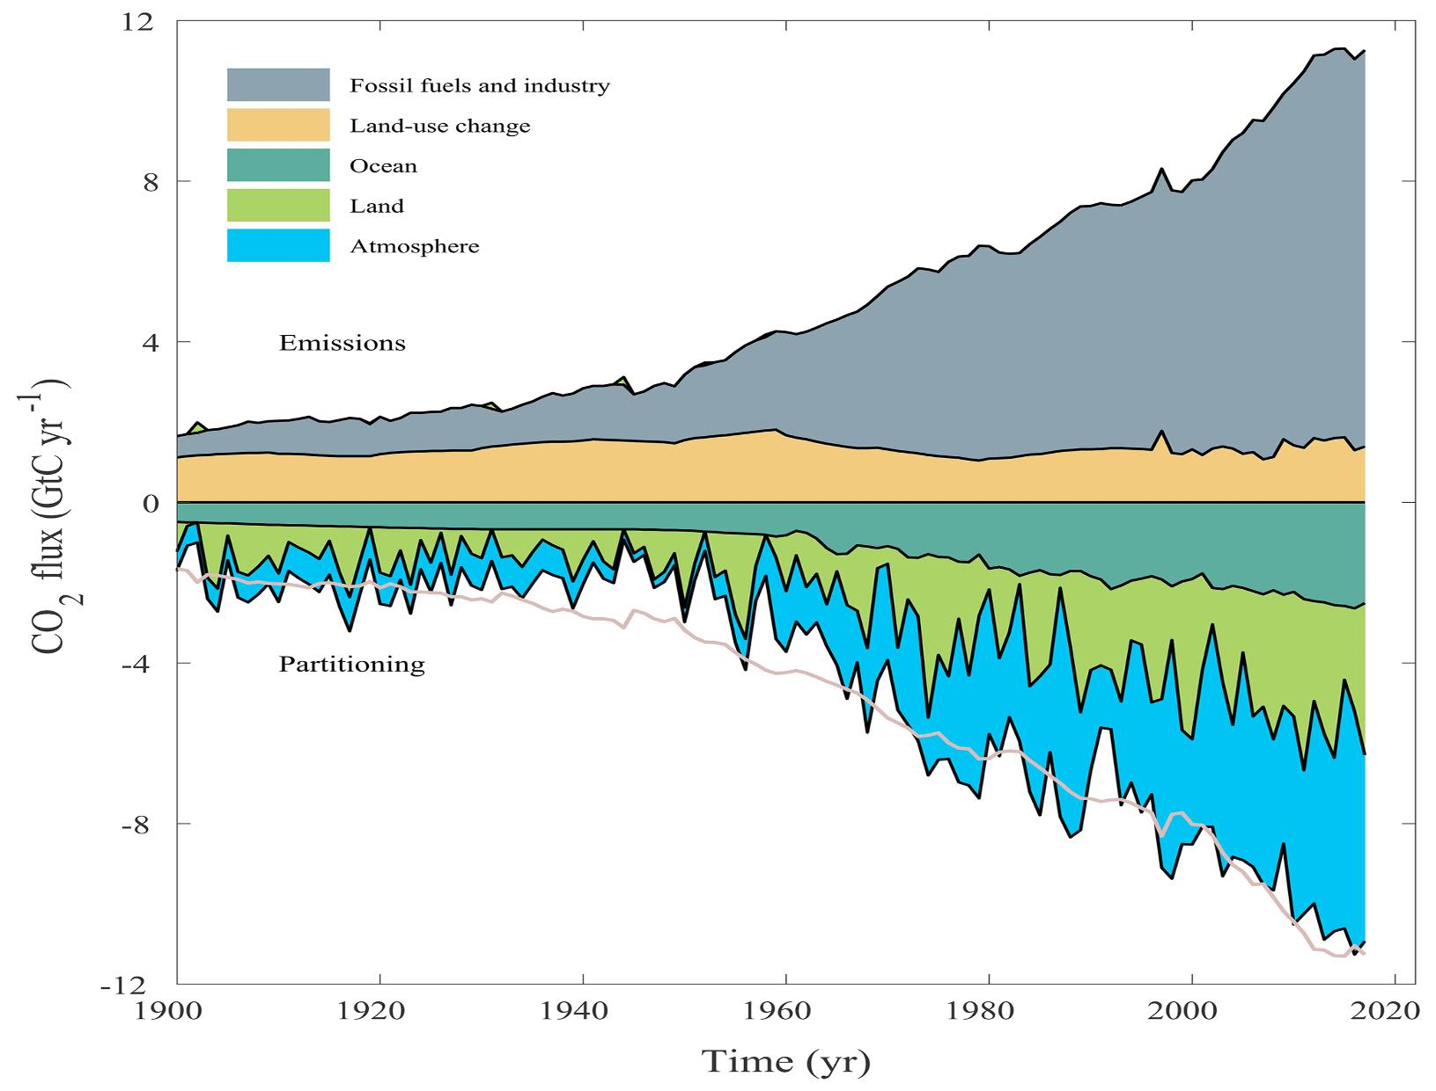
Global trends
Notes:
See figure 3 of Le Quere et al. 2018

Slide 27
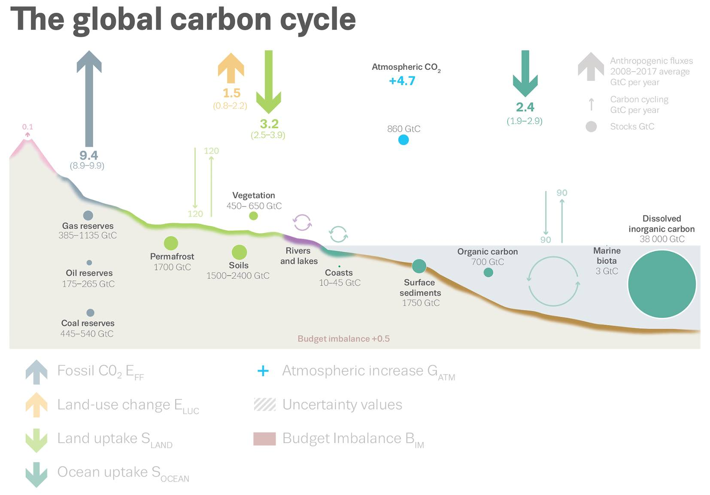
Global trends
Le Quéré et al. 2018

Slide 28
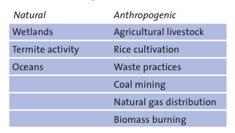
Methane

Slide 29
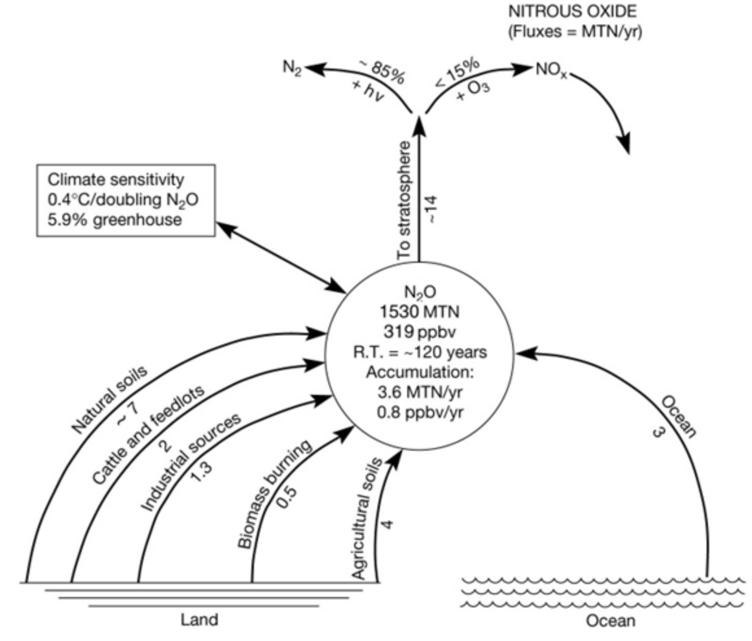
N2O
Anthropogenic activity accounts for around 30% of N2O, with tropical soils and oceanic release account for the majority of the remainder

Slide 30
halocarbons
Refrigerants, aerosols …
Limited by “Montreal Protocol on substances that deplete the Ozone Layer”
Despite control, their continued presence in the atmosphere is of continuing concern for Ozone depletion as well as their role as GHGs.

Slide 31
summary
considered the importance of understanding the science of climate change
looked at basic principles of energy transfer in the earth system
examined greenhouse gases and their sources

Slide 32
Reading
Global Carbon Budget 2020, https://essd.copernicus.org/articles/12/3269/2020/
Myhre, G., D. Shindell, F.-M. Bréon, W. Collins, J. Fuglestvedt, J. Huang, D. Koch, J.-F. Lamarque, D. Lee, B. Mendoza, T. Nakajima, A. Robock, G. Stephens, T. Takemura and H. Zhang, 2013: Anthropogenic and Natural Radiative Forcing. In: Climate Change 2013: The Physical Science Basis. Contribution of Working Group I to the Fifth Assessment Report of the Intergovernmental Panel on Climate Change [Stocker, T.F., D. Qin, G.-K. Plattner, M. Tignor, S.K. Allen, J. Boschung, A. Nauels, Y. Xia, V. Bex and P.M. Midgley (eds.)]. Cambridge University Press, Cambridge, United Kingdom and New York, NY, USA.
Rockstrom, Johan; Steffen, Will; Noone, Kevin; Persson, Asa; Chapin, F. Stuart; Lambin, Eric F.; et al., TM; Scheffer, M et al. (2009). “A safe operating space for humanity”. Nature 461 (7263): 472-475. doi:10.1038/461472a
FAO Global Forest Resource Assessment 2020
https://www.ipcc.ch/sr15/
IPCC Fifth Assessment Report: Climate Change 20xxi1407: Working Group I: The Physical Science Basis and for a brief overview, the IPCC synthesis.

